Slide 1

Chapter 10
Mobile
IP
Copyright © The McGraw-Hill Companies, Inc. Permission required for reproduction or display.

Slide 2
OBJECTIVES:
To discuss addressing issues related to a mobile host and the need for a care-of address.
To discuss two agents involved in mobile IP communication, the home agent and the foreign agent, and how they communicate.
To explain three phases of communication between a mobile host and a remote host: agent discovery, registration, and data transfer.
To mention inefficiency of mobile IP in two cases, double crossing and triangular routing, and a possible solution.

Slide 3
Chapter
Outline
10.1 Addressing
10.2 Agents
10.3 Three Phases
10.4 Inefficiency in Mobile IP

Slide 4
10-1 ADDRESSING
The main problem that must be solved in providing mobile communication using the IP protocol is addressing.

Slide 5
Topics Discussed in the Section
Stationary Host
Mobile Host

Slide 6

Note
The IP addresses are designed to work with stationary hosts because part
of the address defines the network to which the host is attached.

Slide 7
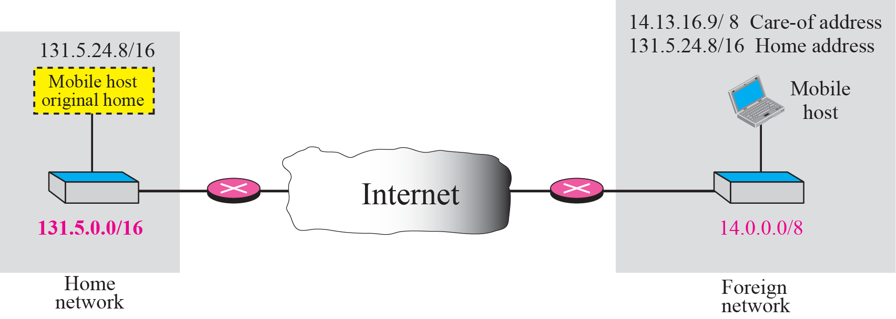
Figure 10.1 Home address and care-of address

Slide 8
Note
Mobile IP has two addresses for a mobile host: one home address and
one care-of address.
The home address is permanent;
the care-of address changes as the
mobile host moves from one
network to another.

Slide 9
10-2 AGENTS
To make the change of address transparent to the rest of the Internet requires a home agent and a foreign agent.

Slide 10
Topics Discussed in the Section
Home Agent
Foreign Agent

Slide 11
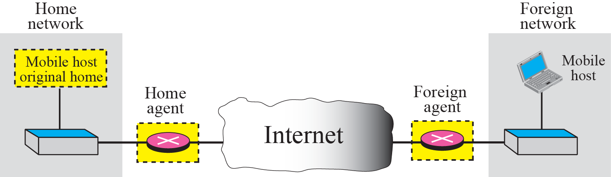
Figure 10.2 Home agent and foreign agent

Slide 12
Note
When the mobile host and the foreign agent are the same, the care-of
address is called a colocated
care-of address.

Slide 13
10-3 THREE PHASES
To communicate with a remote host, a mobile host goes through three phases: agent discovery, registration, and data transfer.
The first phase, agent discovery, involves the mobile host, the foreign agent, and the home agent. The second phase, registration, also involves the mobile host and the two agents. Finally, in the third phase, the remote host is also involved. We discuss each phase separately.

Slide 14
Topics Discussed in the Section
Agent Discovery
Registration
Data Transfer

Slide 15
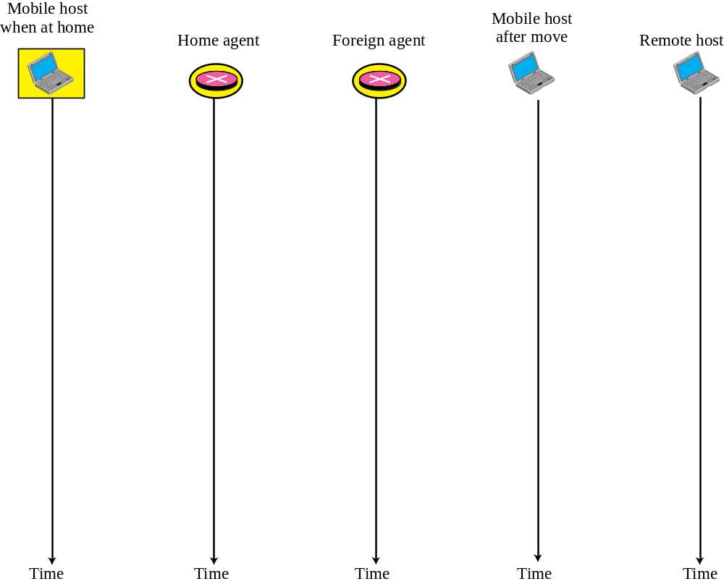

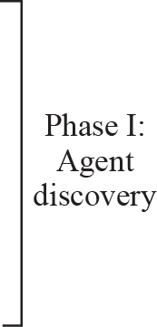
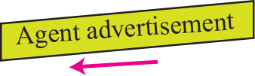


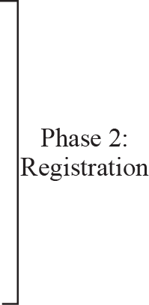




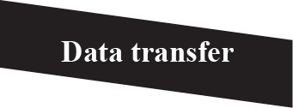
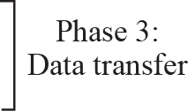
Figure 10.3 Remote host and mobile host configuration

Slide 16
Note
Mobile IP does not use a new packet type for agent advertisement; it uses
the router advertisement packet
of ICMP, and appends an agent advertisement message.

Slide 17
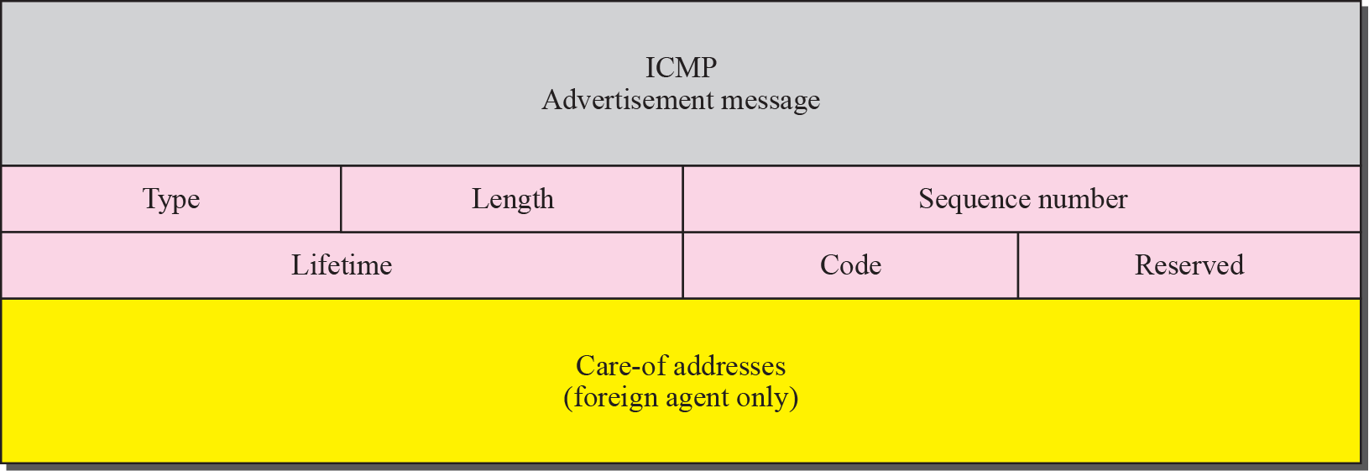
Figure 10.4 Agent advertisement

Slide 18
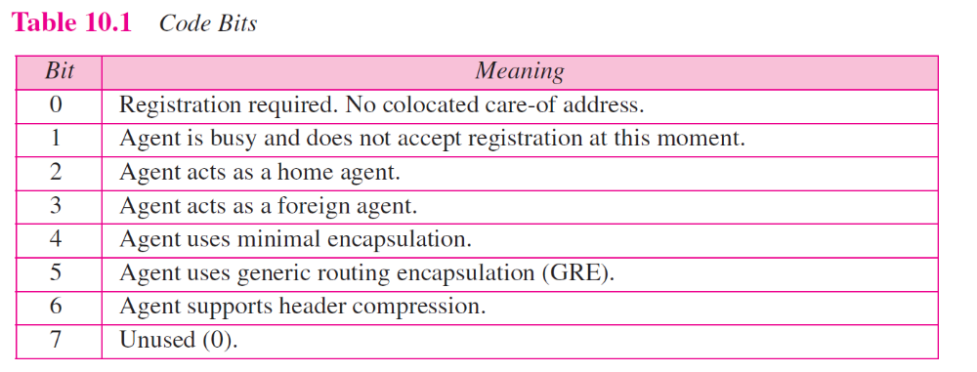

Slide 19
Note
Mobile IP does not use a new packet type for agent solicitation;
it uses the router solicitation
packet of ICMP.

Slide 20
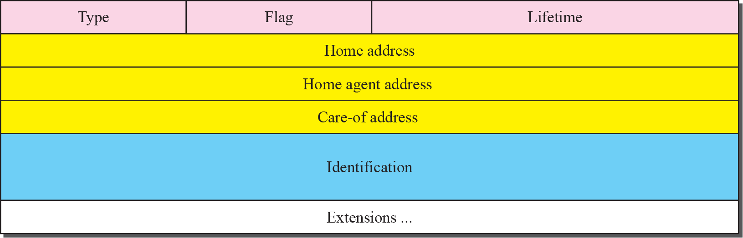
Figure 10.5 Registration request format

Slide 21
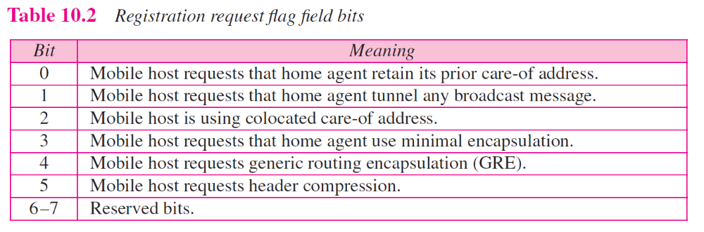

Slide 22
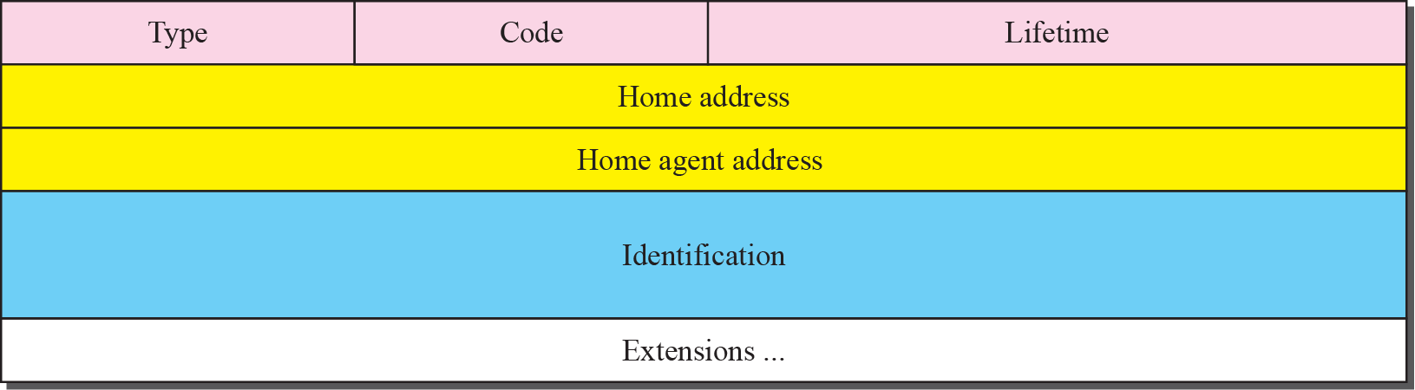
Figure 10.6 Registration reply format

Slide 23
Note
A registration request or reply is sent by UDP using the well-known port 434.

Slide 24
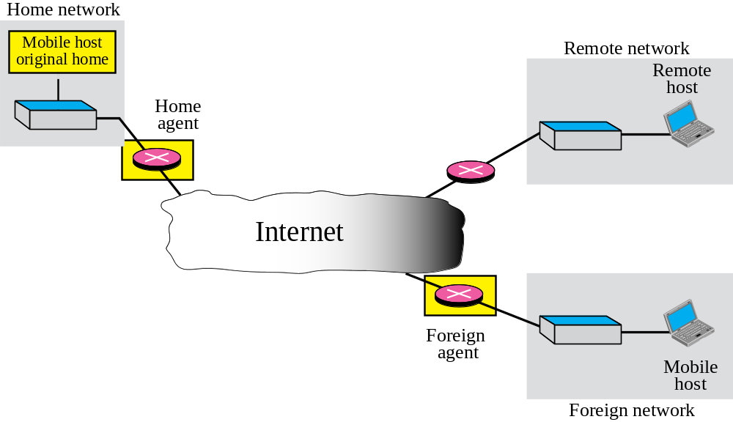
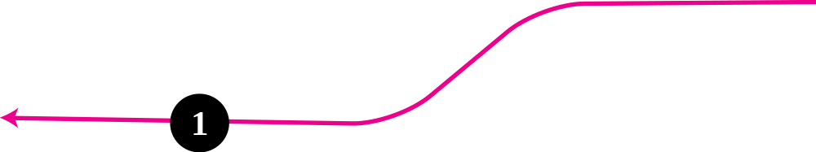
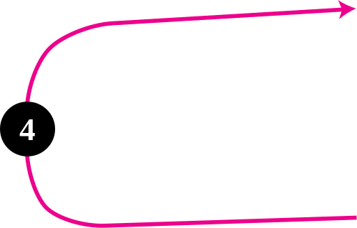
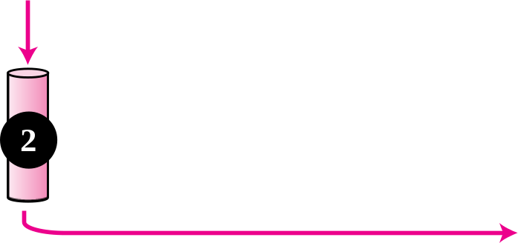
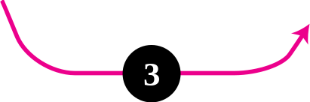
Figure 10.7 Data transfer

Slide 25
Note
The movement of the mobile host is transparent to the rest of the Internet.

Slide 26
10-4 INEFFICIENCY IN MOBILE IP
Communication involving mobile IP can be inefficient. The inefficiency can be severe or moderate. The severe case is called double crossing or 2X . The moderate case is called triangle routing or dog-leg routing.

Slide 27
Topics Discussed in the Section
Double Crossing
Triangle Routing
Solution

Slide 28
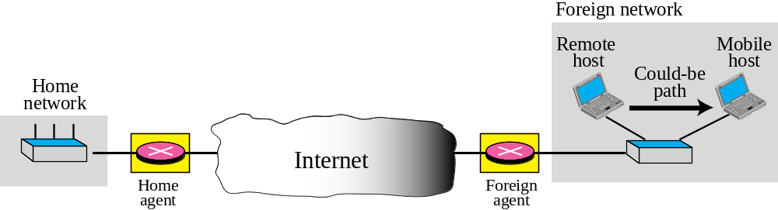
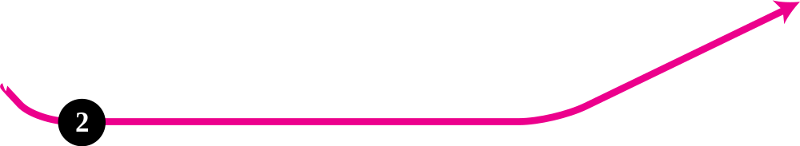
Figure 10.8 Double crossing

Slide 29
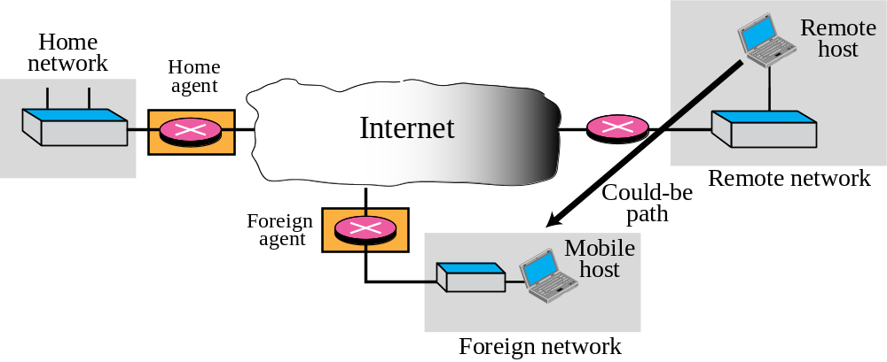



Figure 10.9 Triangle routing

